Slide 1
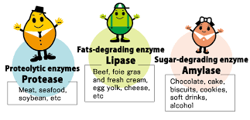
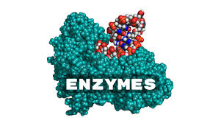
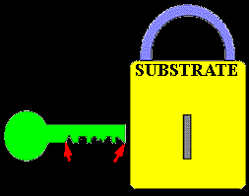
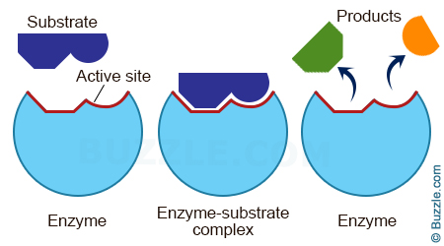
Enzymes

Slide 2
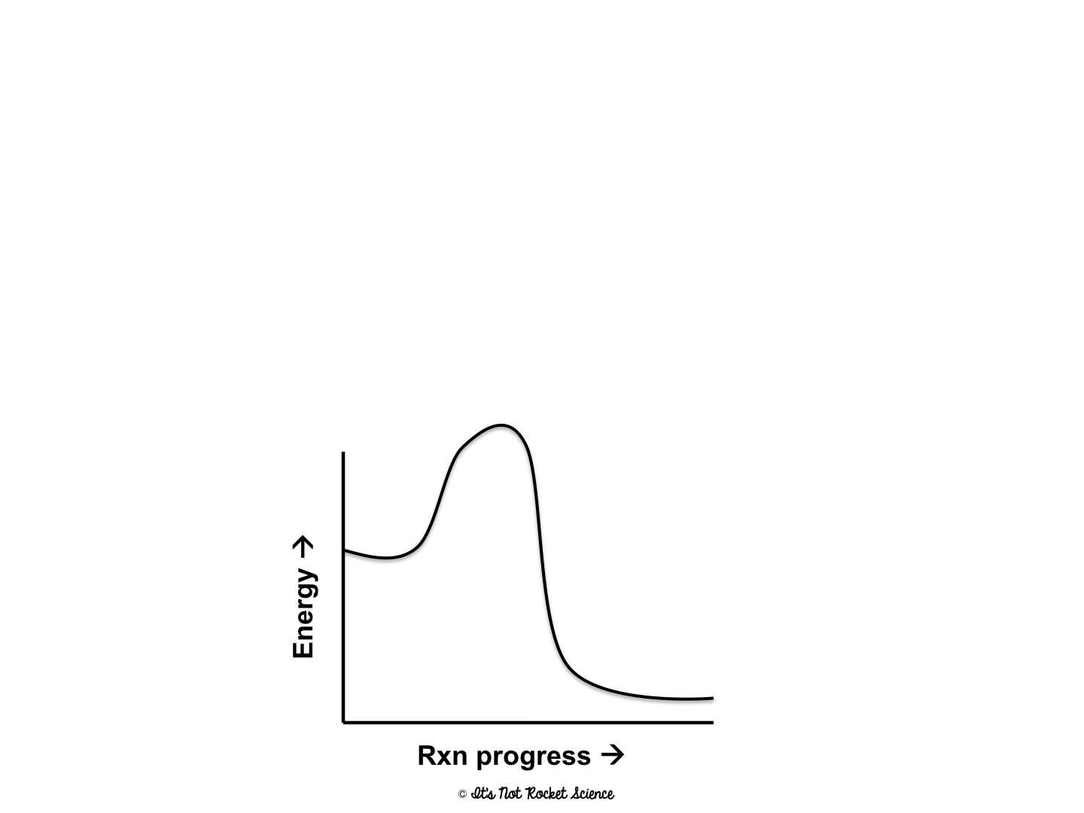
Chemical Reactions
Chemical reactions = the breaking and creating of bonds between different substances (this requires energy)
Activation energy = The amount of energy needed to make a chemical reaction start

Slide 3
Chemical Reactions
Reactants (substrate): substances that are changed during a reaction
Products: substances that are made by a chemical reaction
reactants
products

Slide 4
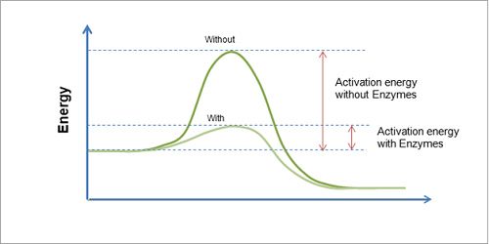
Enzyme Catalzyed Reaction

Slide 5
Enzymes
Enzymes are a type of PROTEIN that speed up biochemical reactions by lowering the activation energy.
Because they speed up reactions, they are called catalysts.
Enzymes are specialized molecules that bind to reactants (aka, substrate) and help to break or form bonds. Then they release a newly created product.
Enzymes are not changed in a reaction and can be used over and over again!

Slide 6
Enzymes
Enzymes are very specific
They have an active site that fits only one substrate (reactant)
This is known as the lock and key model
substrate
(reactant)
active site
enzyme

Slide 7
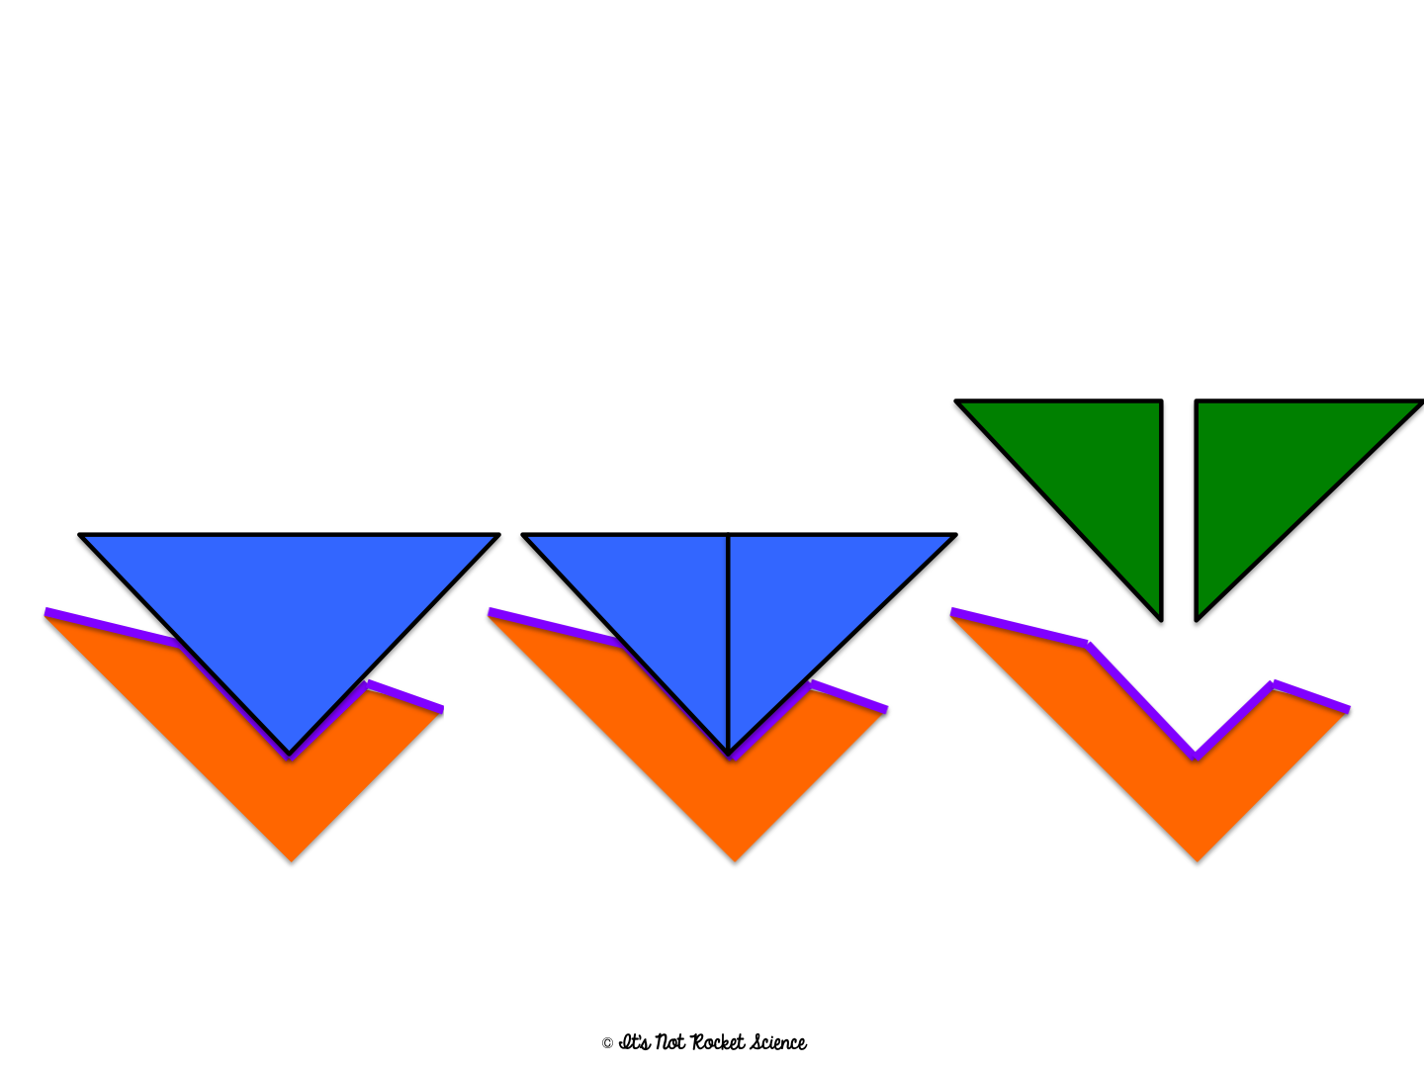
Enzymes
Enzymes can break bonds in a substrate to form two products
Products
Substrate
(Bonds breaking)
enzyme

Slide 8
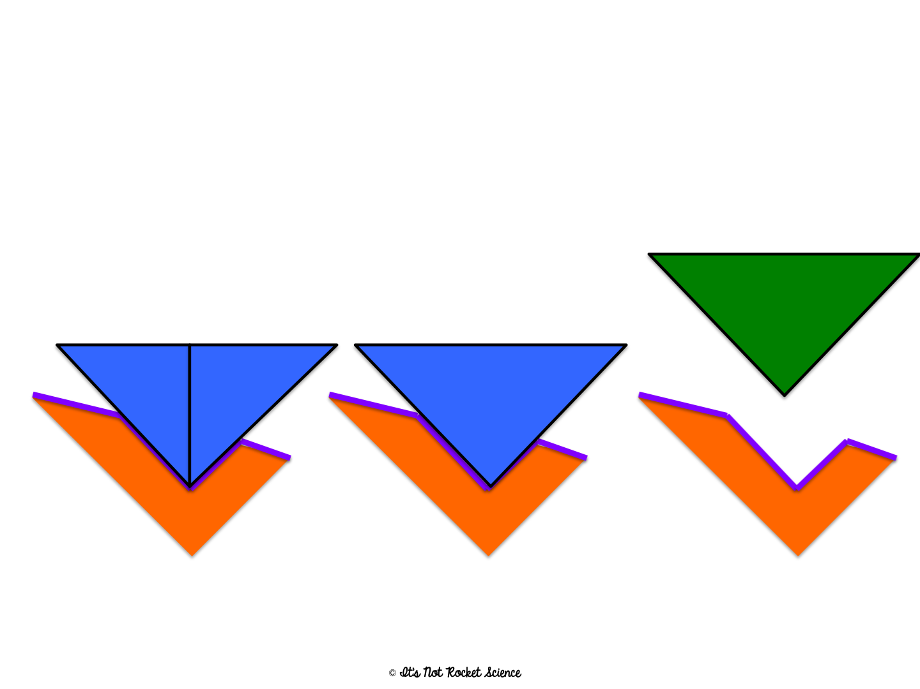
Enzymes
Enzymes can make bonds between substrates to form one product
Product
Substrates
(Bonds forming)
enzyme

Slide 9
Denaturation
Enzyme’s active site gets deformed and loses its specific shape → causes a loss of biological activity
Caused by: extreme changes in pH, temperature, ion strength, and solubility
Enzymes can be “renatured” to their original shape but not always
Normal enzyme
Denatured enzyme

