Slide 1
Organic Molecules
Carbon Compounds
Biological Molecules
Marcomolecules
1

Slide 2
What are Macromolecules?
Macromolecules – large organic molecules (meaning they contain carbon) used for various functions in living things
We can’t live without them!!
EVERYTHING we will learn for the rest of the semester will be based upon one of these macromolecules

Slide 3
Monomers and Polymers
Most macromolecules are polymers, built of monomers.
Monomers: small, basic unit (ex. think Brick)
Polymers: complex structure made of monomers (ex. think Brick House)
3

Slide 4
Types of Organic Molecules (Macromolecules):
Carbohydrates
Lipids
Proteins
Nucleic Acids
4

Slide 5
Carbohydrates:
a. Monomer = Monosaccharides – single sugar molecules
Ex. Glucose, Galactose, Fructose
b. Polymer = Polysaccharides – large molecules formed by monosaccharides.
Ex. Starch, Glycogen, Cellulose
5

Slide 6
Carbohydrates
Main Function= short-term ENERGY
Other uses = structure/support
Found in: sugar and starch (therefore breads, pastas, fruits and veggies)
6

Slide 7
Carbohydrates
Energy Storage = 4 calories/milligram
Because it is short term energy, your body can access it very easily so it is the FIRST thing you will break down to get energy when you need it!
7

Slide 8
Lipids
Monomer = Glycerol and 3 Fatty Acids
Polymer = fats, oils, phospholipids, steroids, hormones
8

Slide 9
Lipids
Energy Storage = 9 calories/milligram
When your body runs out of carbs, it will then break down lipids to get energy

Slide 10
Lipids
Main Function= Long-term Energy Storage
Other uses = cushioning organs, insulation, hormones, cell membrane
Found in: Fats, oils, phospholipids (in the cell membrane), steroids
10

Slide 11
Phospholipids = a special lipid
Structure = 2 fatty acids and one phosphate.
These molecules are found making up the plasma membrane of cells.
The phosphate group is hydrophilic while the fatty acid area is hydrophobic.

Slide 12
Proteins
Most diverse macromolecule
Most abundant macromolecule (make up 50% of cell’s biomass)
They literally RUN your body!!
12

Slide 13
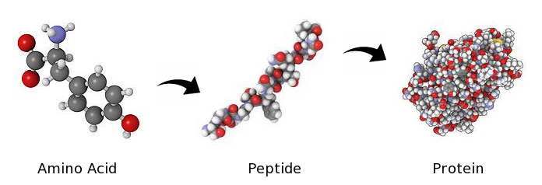
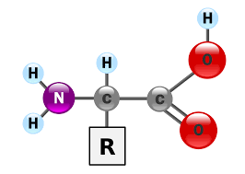
Proteins
Monomer = Amino Acids
Polymer = Polypeptide
(amino acids are linked
together by a peptide bond)
13

Slide 14
Functions of Proteins
1. Enzymes control the rate of chemical reactions
2. Hormones regulate cell processes (ex. Insulin)
3. Used to form bones and muscles (ex. Collagen)
4. Transports substances in & out of cells (ex. Hemoglobin)
5. Antibodies help fight diseases
14

Slide 15
Proteins
Found in = meats, nuts, Greek yogurt, etc.
Examples in your body include hemoglobin and insulin
Energy Storage = 4 calories/milligram
Because they have so many other uses though, they are the LAST thing your body will break down if it needs energy

Slide 16
Importance of Folding:
Form dictates function
The shape of the protein determines what it does
16

Slide 17
Nucleic Acids
Structure
Monomers = nucleotides
Ex. A, G, T, C, U
5-carbon sugar
Phosphate group
Nitrogenous base
Polymer = Nucleic Acid
Ex. DNA and RNA
17

Slide 18
Nucleic Acids
Main Function: store & transmit hereditary or genetic information
Ex. DNA, RNA
You get them from your PARENTS not your food!
18

