Slide 1
Pedigree
Pedigree – chart used to trace the phenotypes and genotypes in a family to determine whether people carry diseases or traits
Similar to a family tree, but it traces a trait or disease through the family line
Can be used by potential parents or genetic counselors to determine the probability of passing on the disease to children.
Studying pedigrees can help scientists determine the inheritance pattern for a trait (dominant or recessive, sex-linked or autosomal)

Slide 2
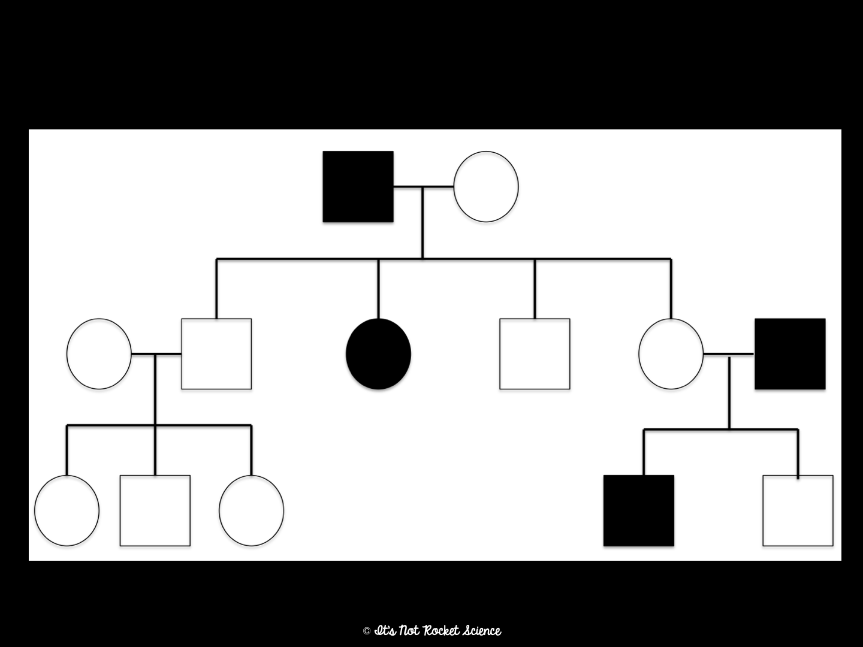
Pedigree Notation
Male
Female
I
Married
Kids
II
III
Has it
Doesn’t have it

Slide 3
Autosomal Recessive
Most common inheritance pattern for genetic diseases
Disease is rare in the family (only a few affected family members)
Males and females are equally likely to inherit this disease
Disease often skips generations (a child may inherit the disease even though neither of the parents have the disease.)
Examples: Cystic Fibrosis, Sickle Cell Anemia, Phenylketonuria (PKU), Tay-Sachs Disease.

Slide 4
Autosomal Recessive Example

Slide 5
Autosomal Dominant
Disease is common in the family (many affected family members)
Males and females are equally likely to inherit this disease.
Disease will never skip a generation – a child cannot inherit the disease if both parents are healthy!
Examples: Achondroplasia (dwarfism), Huntington’s Disease, Neurofibromatosis

Slide 6
Autosomal Dominant Example

Slide 7
Sex-Linked Recessive
Disease is rare in the family (only a few affected family members)
Disease often skips generations
Males are more often affected than females
Affected fathers DO NOT pass on to their sons! (Why??)
Examples: Hemophilia, Duchene Muscular Dystrophy, Colorblindness

Slide 8
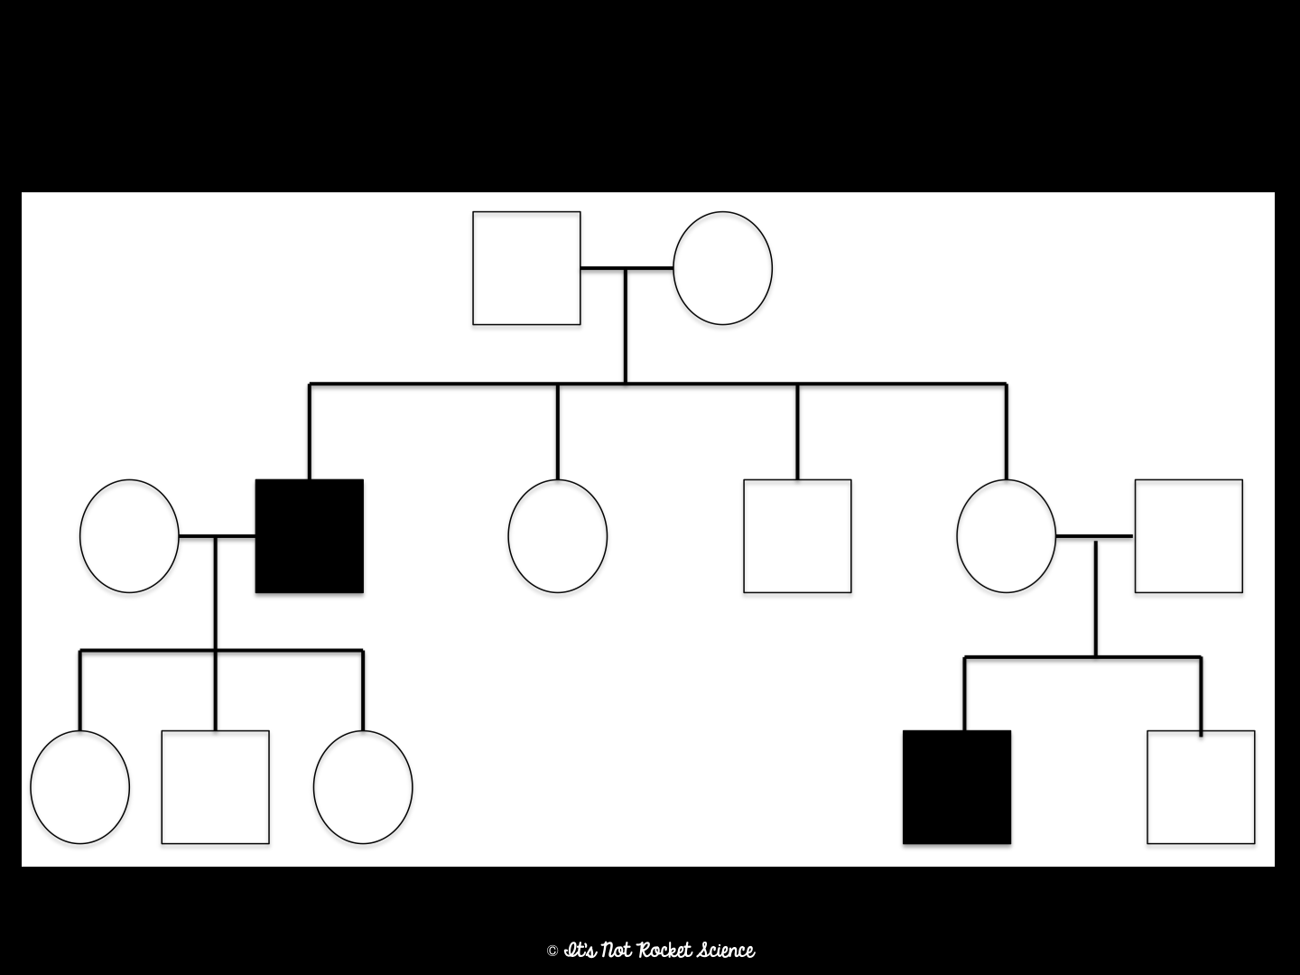
Sex-Linked Recessive Example

Slide 9
How to determine the pattern of inheritance in a pedigree:
If there are way more males than females affected (shaded in,) than the pedigree is tracing a Sex-Linked trait.
If not, look for two parents that are the same shade that have a child who is different from them. Label that child homozygous recessive (Ex. rr) and the parents heterozygous (Ex. Rr)
If the child was shaded, the pedigree is tracing an Autosomal Recessive trait.
If the parents were shaded, the pedigree is tracing an Autosomal Dominant trait.

Slide 10
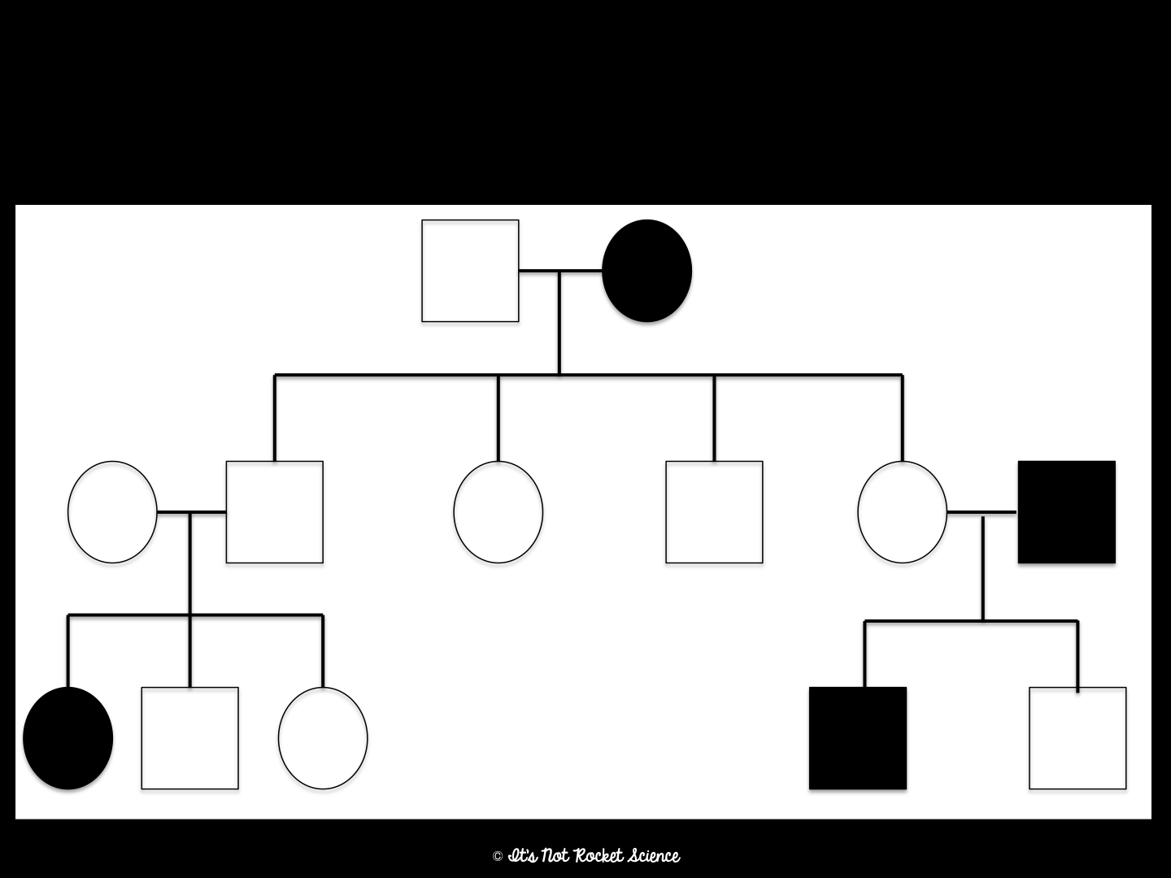
Example #1
Determine the inheritance pattern and label the genotypes.
Autosomal Recessive
R?
rr
Rr
Rr
Rr
Rr
Rr
rr
rr
R?
R?
rr
Rr

Slide 11
Example #2
Determine the inheritance pattern and label the genotypes.
Sex-Linked Recessive
X^{r}Y
X^{R}X^{r}
X^{R}X^{r}
X^{r}Y
X^{R}X^{r}
X^{R}X^{r}
X^{R}Y
X^{r}X^{r}
X^{R}Y
X^{R}X^{r}
X^{r}Y
X^{R}Y

