Slide 1
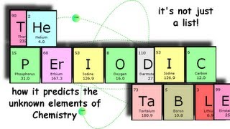
THE PERIODIC TABLE

Slide 3
The Big Questions
Who developed the first periodic table?
How did he organize it, and how does this differ from the organization of the P. T. today?
What are some ways in which we group elements on the P. T.?
What does this tell us about the atom’s structure?

Slide 4
PATTERNS

Slide 5
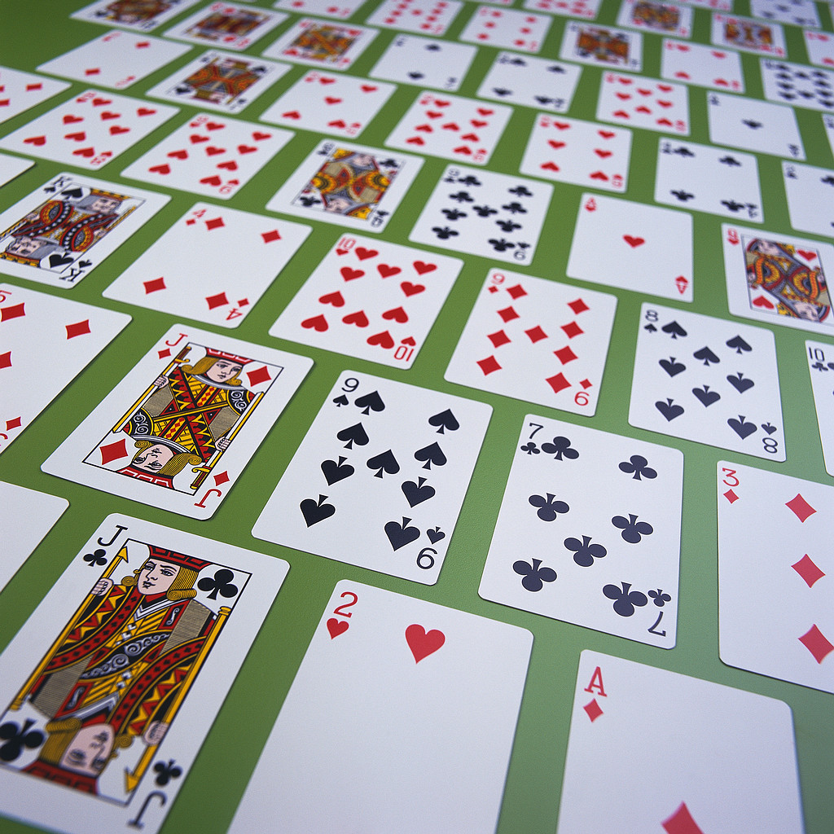

Slide 6
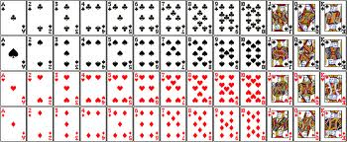

Slide 7
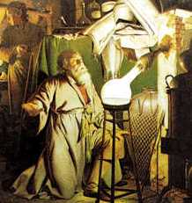
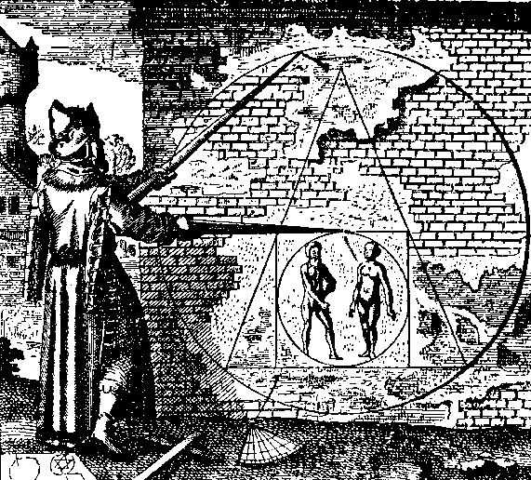
Hennig Brand
First known discoverer of an element: Phosphorus (found it in urine)
Was looking for the
Philosopher's Stone

Slide 8
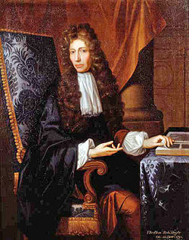
Robert Boyle
Defined element as we know it today
Element: simplest substance that cannot be broken down
chemical means

Slide 9
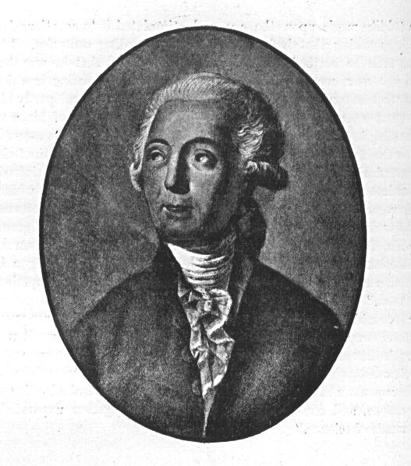
Antoine-Laurent de Lavoisier
Wrote Elementary Treatise of Chemistry (1789)
First chemical textbook that listed known elements

Slide 10
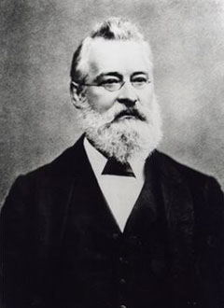
John Newlands
Similar chemical and physical properties –
Periodic Law

Slide 11
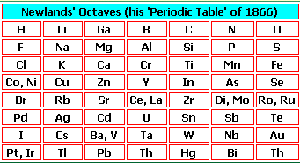
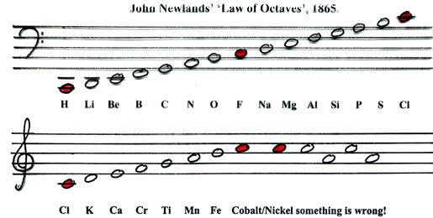
Divided groups into 11 groups
Noticed that pairs of similar elements differ by 8 in mass number
Called this his law of octaves

Slide 12
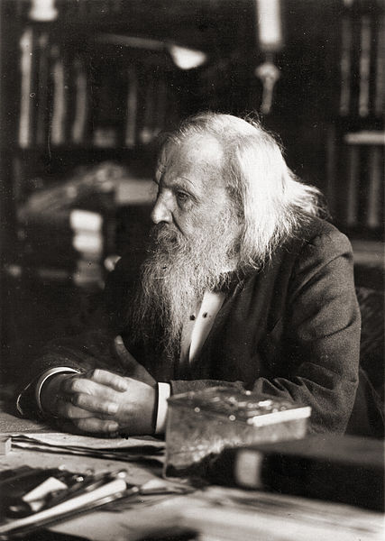
Dmitri Mendeleev

Slide 13
Increasing Atomic Mass

Slide 14
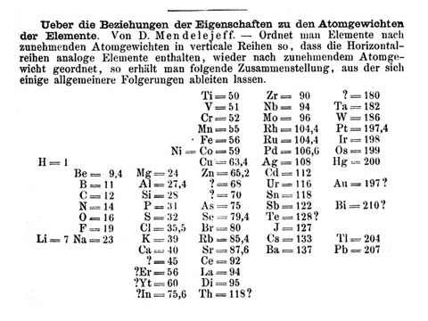
The First Periodic Table

Slide 15
The Mendeleev P. T.
DM noticed there were “holes” where no known element would fit.
Guessed that these holes represented undiscovered elements.
Made predictions about their properties.
When discovered, these elements matched their predicted properties.

Slide 16
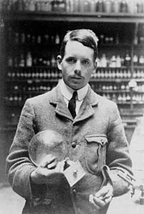
Henry Moseley
Arranged by increasing
Atomic Number

Slide 18
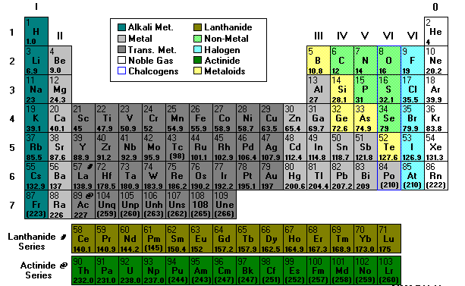
Modern Periodic Table

Slide 19
PERIODIC LAW

Slide 20
When elements are arranged to atomic numbers, elements with similar properties appear at regular intervals.

Slide 21
STRUCTURE OF PERIODIC TABLE
GROUP
PERIOD

Slide 22
Metals, Metalloids, and Nonmetals
Nonmetals
Metals
Metalloids

Slide 23
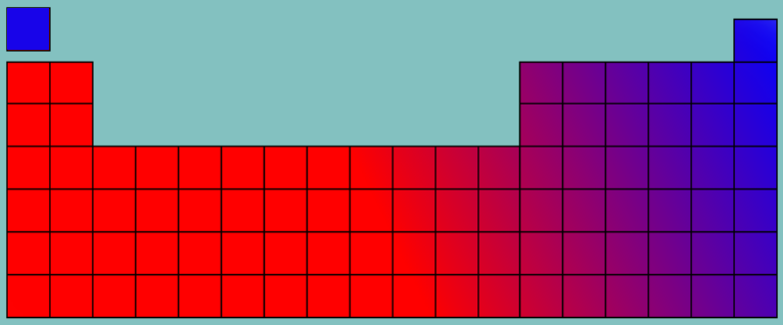
Metallicity
More Metallic
Less Metallic
Less Metallic
More Metallic

Slide 24
The Octet Rule
Atoms tend to gain or lose electrons so they can have 8* valence electrons (same e⁻ configuration as a noble gas).
Why?
8 valence electrons = full s and p sublevel.
Extremely stable configuration.
*There are a few exceptions to this rule that we will discuss later.

Slide 25
Ions
Atoms can lose or gain electrons.
Ion – an atom that has become charged by gaining or losing electrons.
Cation – positive ion (lost e⁻)
Anion – negative ion (gained e⁻)

Slide 26
Ions
6 p⁺
7 e⁻
6 p⁺
6 e⁻
6 p⁺
5 e⁻
Gain 1 e⁻
Lose 1 e⁻
C⁻
C
C⁺

Slide 27
Families of Elements
Families – columns or groups.
Elements in a family have similar chem. properties.
Also have same no. of valence e⁻.
Coincidence? (No.)

Slide 28
Blocks
s-block
p-block
d-block
f-block

Slide 29
Electron Configs. on the P. T.
1s
1s
2s
2p
3s
3p
4s
3d
4p
5s
4d
5p
6s
5d
6p
7s
6d
7p
4f
5f

Slide 30
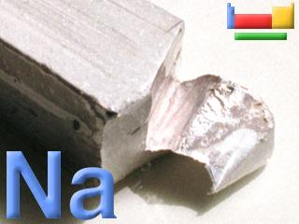
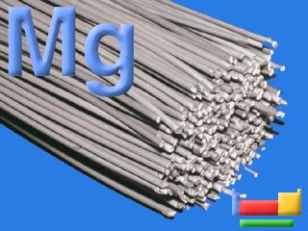
Families of the Periodic Table
The s-block elements:
Groups 1–2: (Representative elements)
Group 1 (1A)
Alkali Metals
• Soft, silvery
• Very reactive (never found alone in nature)
• ns¹ (ex. 1s² 2s¹)
• 1 val. e⁻
• Form +1 ions
Group 2 (2B)
Alkaline earth metals
• Harder, denser, stronger than alkali metals
• Reactive (never found alone in nature)
• ns² (ex. 1s² 2s²)
• 2 val. e⁻
•Form +2 ions.

Slide 31
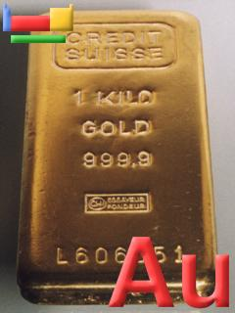
Families of the Periodic Table
Groups 3 –12(3 – 12)
Transition metals
Typical metallic properties
Less reactive than group 1,2
ns² (n-1)d¹⁻¹⁰ (ex. 1s²2s²2p⁶3s²3p⁶4s²3d⁸)
Have variable val. e⁻
Can form multiple cations

Slide 32
Families of the Periodic Table
The p-block elements:
Groups 13 (3A) –18 (8A): (Representative elements)
Includes:
Metalloids, nonmetals, metals
ns² np¹⁻⁶ (ex. 1s²2s²2p⁶3s²3p⁴)

Slide 33
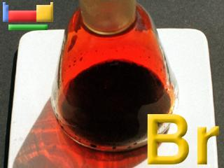
Families of the Periodic Table
Group 17 (7A)
Halogens
react with most metals to form salt compounds
7 val. e⁻
Form –1 ions
Group 18 (8A)
Noble gases
•inert gases (not reactive)
•both s and p sublevels = full (8 electrons)
(exc. He) ns² np⁶
Do not form ions

Slide 34
Families of the Periodic Table Main Group Elements
The s and p block elements:
Groups 1–2, 13-18: (Representative elements)

