Slide 1
Periodic Trends

Slide 2
Periodic Trends
Nuclear Charge
Shielding
Atomic Radius

Slide 3
Nuclear Charge
Charge of the nucleus

Slide 4
Increases() Across Period

Slide 5
Increases () Down Group

Slide 6
Periodic Trends
Nuclear Charge
Shielding
Atomic Radius

Slide 7
SHIELDING
Lower energy levels “shield” higher energy levels from full nuclear charge

Slide 8
NO CHANGE ACROSS PERIODS

Slide 9
Increases () Down Group

Slide 10
Periodic Trends
Nuclear Charge
Shielding
Atomic Radius

Slide 11
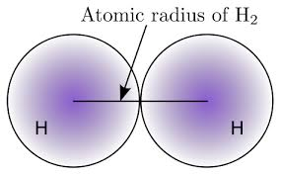
Atomic Radius
Size of the atom

Slide 12
Decreases () Across Period

Slide 13
Increases () Down Group

Slide 14
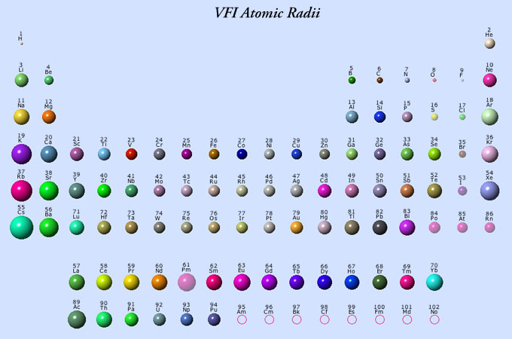

Slide 15
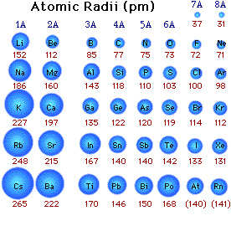

Slide 16
IONS
An atom or group of atoms that have a positive or negative charge
Form when electrons are transferred b/w atoms

Slide 17
Cations
Positively charged ion
Form by losing electron(s)
Smaller than original atom
Metals

Slide 18
Anions
Negatively charge ion
Form by gaining electron(s)
Larger than original atom
Non-metals

Slide 19
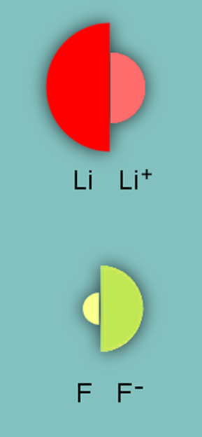

Slide 20
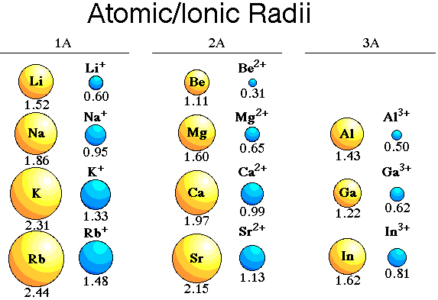
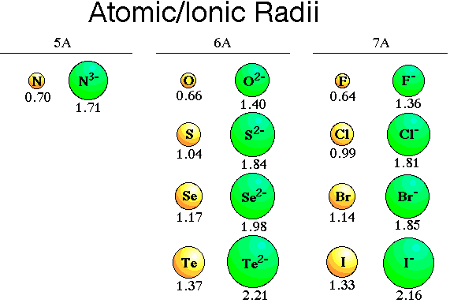

Slide 21
PERIODIC TRENDS
Ionic Radius
Ionization Energy
Electronegativity

Slide 22
IONIC RADIUS
Size of the Ion

Slide 23
Decreases () Across Period
Cations smaller than anions-trend restarts with NM

Slide 24
Increases () Down Group

Slide 25
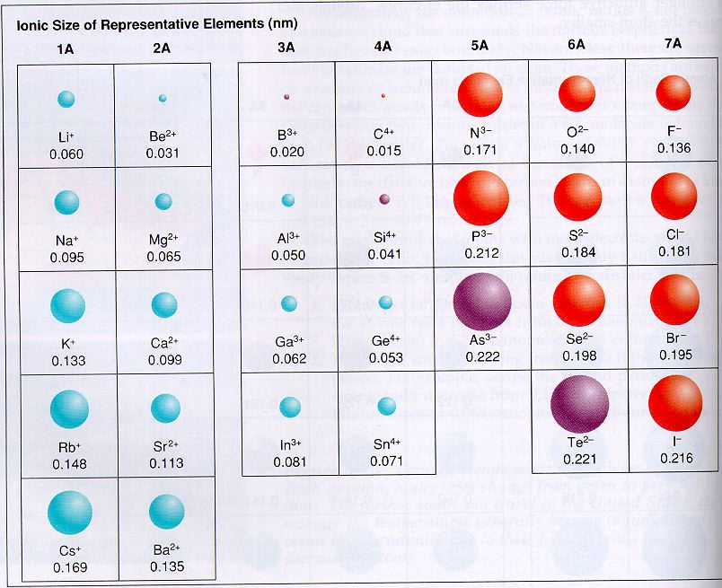

Slide 26
PERIODIC TRENDS
Ionic Radius
Ionization Energy
Electronegativity

Slide 27
Ionization Energy
Energy requires to remove an electron

Slide 28
Increases () Across Period

Slide 29
Decreases () Down Group

Slide 30
Ionization Energy
1st ionization energy = +1 charge ion
2nd ionization energy = +2 charge ion
3rd ionization energy = +3 charge ion.

Slide 31
PERIODIC TRENDS
Ionization Energy
Ionic Radius
Electronegativity

Slide 32
Electronegativity
Ability of an atom to attract electron(s)

Slide 33
Increases () Across Period

Slide 34
Decreases () Down Group

Slide 35
Reactivity
Metals
Give up electrons to become more reactive
Nonmetals
Take on electrons to become more reactive

Slide 36
Reactivity
Metals
Decreases () Across Period

Slide 37
Reactivity
Metals
Increases () Down Group

Slide 38
Reactivity
Nonmetals
Increases () Across Period

Slide 39
Reactivity
Nonmetals
Decreases () Down Group

