Slide 1
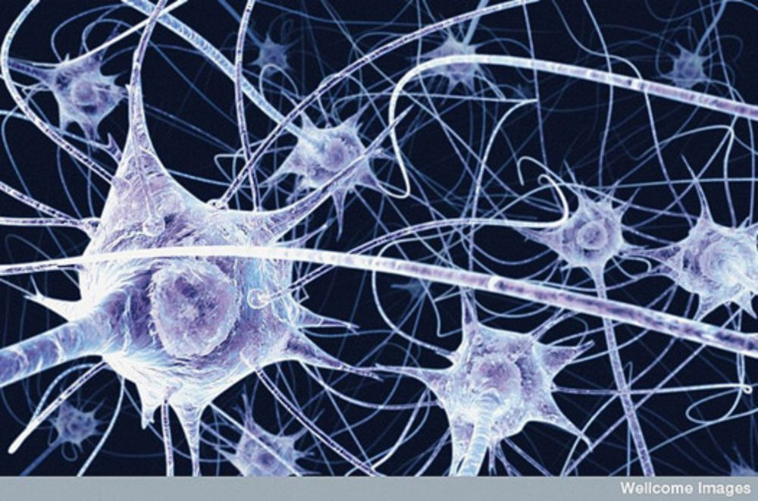
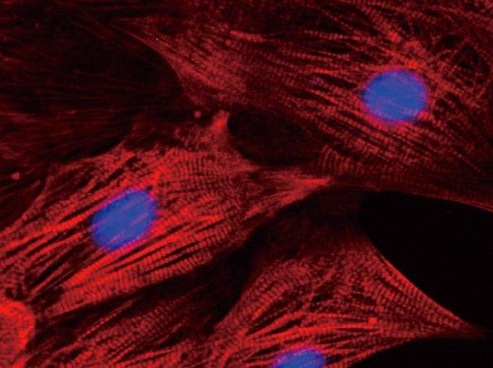
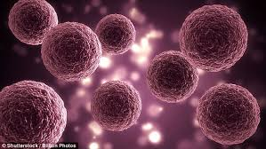
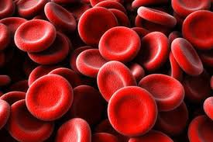
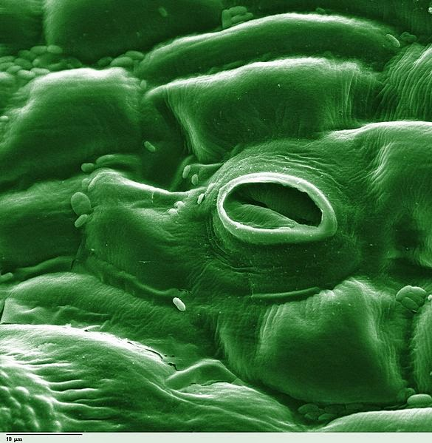
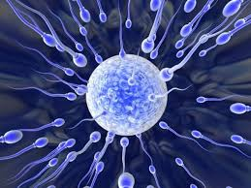
Cells

Slide 2
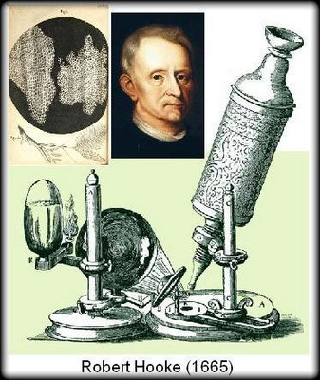
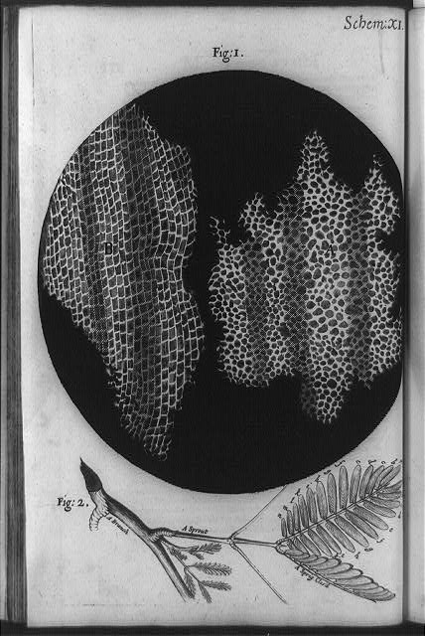
Cells
Robert Hooke:
mid-1600’s
Viewed cork (plant material) –saw empty chambers “cells”

Slide 3
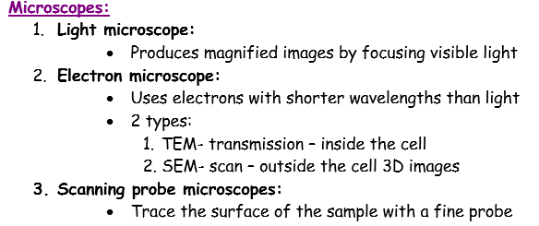
Cells
http://www.classzone.com/cz/find_state.htm

Slide 4
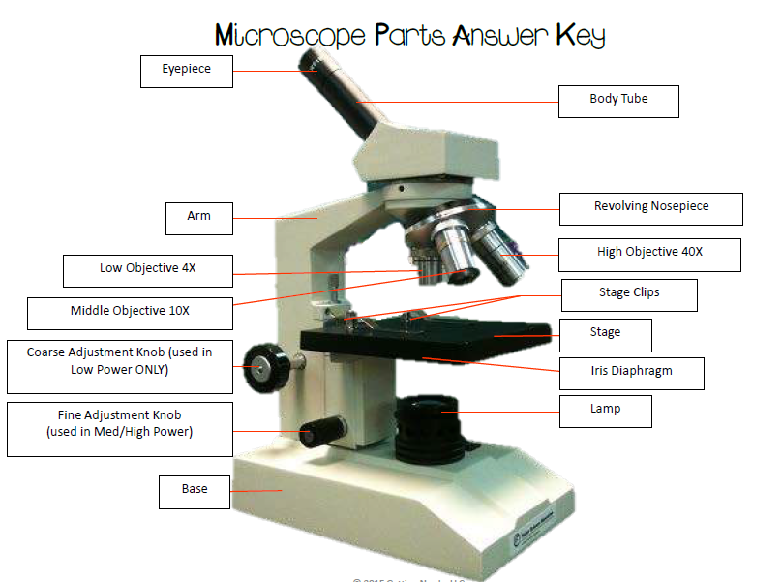

Slide 5
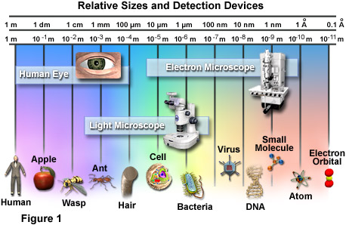
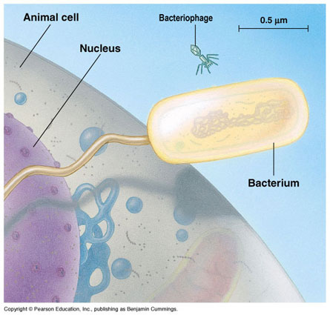
Cells
http://learn.genetics.utah.edu/content/cells/scale/

Slide 6
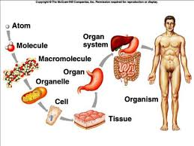
Level of Organization

Slide 7
Cells
Unicellular – One cell = organism
Multicellular –
Many cells = organism
Cells are specialized

Slide 8
What are Cells?
Cells are the basic building blocks of all living things.
The human body is composed of trillions of cells.
They provide structure for the body, take in nutrients from food, convert those nutrients into energy, and carry out specialized functions.
Cells also contain the body’s hereditary material and can make copies of themselves.

Slide 9
Cell Theory
1. All living things are made of cells.
2. Cells are the basic unit of life.
3. All cells come from other cells.

Slide 10
Cells
Two types:
Prokaryotic
Eukaryotic
Notes:
To give students an idea of scale in terms of the size of the cell, check out this site:
http://learn.genetics.utah.edu/content/cells/scale/

Slide 11
Cells
2. Cells are the most basic unit of life.
Two types:
 | Prokaryotic | Eukaryotic
Nucleus?
Membrane-bound organelles?
Division?
Size of organisms?
Cell walls?
Ex. of organisms with this type of cell?
no
yes
no
yes
Binary fission
mitosis
unicellular
uni- or multicellular
Yes, made of peptidoglycan
Only fungi and plants, made of chitin or cellulose
Animals, plants, fungi, protists
Bacteria

Slide 12
Cells –Prokaryotes and Eukaryotes
Although there are two types, all cells have:
Cell membrane
Cytoplasm
Ribosomes
Genetic material (DNA or RNA)
Notes:
To give students an idea of scale in terms of the size of the cell, check out this site:
http://learn.genetics.utah.edu/content/cells/scale/

Slide 13
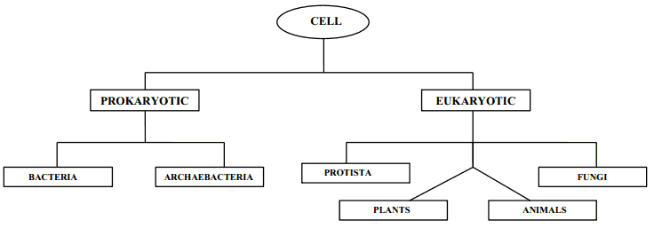

Slide 14
Organelles
Specialized structures within the cell that work together to help the cell function “little organs”
Think of them as “little organs” within the cell working together for one main purpose → TO MAKE PROTEINS! #proteinsmatter

Slide 15
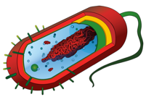
Bacteria Cell

Slide 18
Cell (Plasma) Membrane
Structure
Surrounds the outside of ALL cells!
Made of two layers (known as the phospholipid bilayer)
Job
Controls what goes in and out of the cell

Slide 19
Phospholipid Bilayer
2 layers of fats
Fats = phospholipids
LOTS of Proteins
“Fluid-Mosaic Model- composed of many parts that move around freely

Slide 20
Cytoskeleton
Structure
Threadlike fibers
Made of proteins
Job
Give the cell shape
Can also move organelles around
Provide structural support

Slide 21
Cytoplasm
Structure
Jelly-like substance
Mainly made up of water
Job
Holds everything in place

Slide 22
Nucleus
Structure
Control Center
Contains DNA (genetic material)
Surrounded by a nuclear membrane/envelope with pores that control what goes in and out
Job
Protect the DNA that controls the activities of the cell

Slide 23
Nucleolus
Structure
Inside of the nucleus
Job
Makes rRNA which make up ribosomes

Slide 24
Ribosomes
Structure
Made of proteins and rRNA
Located on Rough ER and floating in cytoplasm
Job
Make proteins!!!

Slide 25
Rough ER (Endoplasmic Reticulum)
Structure
Has ribosomes on surface
Hugs the nucleus
Job
Makes proteins!!! (assembles and exports proteins)

Slide 26
Smooth ER (Endoplasmic Reticulum)
Structure
No ribosomes on surface
Attached to Rough ER
Job
Makes lipids (membrane) (assembles and exports)

Slide 27
Golgi apparatus
Structure
Folded membrane
Job
modifies, sorts, and ships proteins/materials where needed from ER

Slide 28
Lysosomes
Structure
Contain digestive enzymes
Job
Breakdown dead stuff (food, bacteria, old parts of cell, etc.); Clean up crew.

Slide 29
Vacuoles
Structure
Small and numerous in animal cells
One large central one in plant cells
Job
Storage (water, nutrients, waste, etc.)

Slide 30
Centrioles/Centrosomes
ANIMAL CELLS ONLY!!
Structure
Made of microtubules
Job
Appear during cell division
Help cell divide by pulling chromosomes apart

Slide 31
Cilia and Flagella
ANIMAL (and Bacteria) CELLS ONLY!!
Structure
Cilia: shorter, more numerous, like tiny oars
Flagella: longer, fewer (1-3)
Job
Cilia: move fluid across cell surface
Flagella: move entire cell

Slide 32
Mitochondria
Structure
Two parts: inner membrane and matrix (fluid part)
Job
Where cellular respiration happens
Breaks down food to release energy as ATP
POWERHOUSE OF THE CELL

Slide 33
Chloroplast
PLANT CELLS ONLY!!
Structure
Two parts: grana (stacks) and stroma (fluid)
Job
Where photosynthesis happens
Converts energy from sun → energy in sugar

Slide 34
Cell Wall
PLANT (and bacteria) CELLS ONLY!!
Structure
Made of cellulose (in plants), chitin (in fungi), and peptidoglycan (in bacteria)
Job
Protect and maintain shape

Slide 35
Cell Differentiation or Cell Specialization:
Cells develop in alternative ways to perform different tasks
Eukaryotic cells
Multicellular organisms
ex. Red blood cells are specialized to
transport oxygen
Guard cells in plants open and close
the stomata

Slide 36
Cell Communication:
Cells communicate by sending and receiving signals
Signals may come from the environment, or they may come from other cells
To trigger a response, signals must be transmitted across the cell membrane
Phototaxis- toward(+), away(-) light
Chemotaxis-toward(+), away(-) chemical stimuli

