Slide 1
Homeostasis
The need of an organism to maintain and regulate constant or stable internal conditions.
How does your body regulate (aka maintain homeostasis)?
Temperature, pH, and the concentration of other materials and nutrients must be maintained within a relatively narrow margin.
Much of homeostasis is maintained by the cell membrane controlling movement of things in and out of the cell

Slide 2
Cell Membrane
Cell membrane:
Regulates what enters and leaves the cell
Lipid bilayer (phospholipid)- flexibility and barrier (selectively permeable)
Proteins – channels and pumps
Carbohydrates – act like chemical identification cards

Slide 3
Words to Know
Solute – what gets dissolved (Ex. Lemonade powder)
Solvent – does the dissolving (Ex. Water)
Solution – uniform mixture of two or more substances (Ex. Lemonade)
Concentration – amount of solute dissolved in solvent
Symbol for abbreviation = [ ]

Slide 4
Cellular Transport
Passive Transport Movement of particles across the cell membrane from high concentration to low concentration
Requires NO energy
Active Transport Movement of particles across the cell membrane against concentration difference (low to high)
Uses transport proteins (“pumps”)
Requires energy (ATP)

Slide 5
Passive Transport:
HIGH to LOW
NO ENERGY

Slide 6
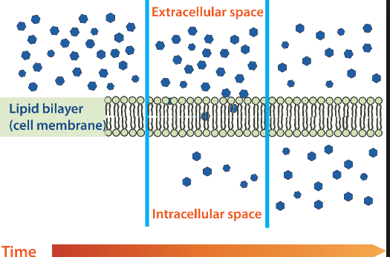
Passive Transport: Diffusion
Movement of particles (solutes) from an area of high concentration to an area of low concentration
Ex. Oxygen and Carbon Dioxide

Slide 7
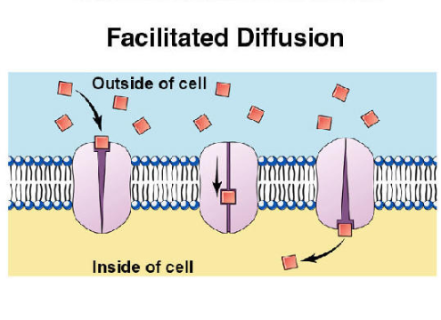
Passive Transport: Facilitated Diffusion
Movement of particles (solutes) through protein channels from an area of high concentration to an area of low concentration
Ex. Glucose/sugar, sodium/salt

Slide 8
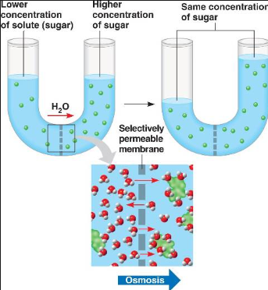
Passive Transport: Osmosis
Movement of water from an area of high concentration to an area of low concentration
Over time…

Slide 9
Passive Transport: Osmosis
Hypertonic solutions: Higher solute concentration
More concentrated (“above strength”) solution than cell Water will move out of the cell→ Cell shrivels
Hypotonic solutions: Less solute concentration
Less concentrated (“below strength”) solution than cell Water will move into the cell→ Cell swells
Isotonic solutions: Equal solute concentrations on both sides of the cell membrane (“same strength”) → Cell stays the same

Slide 10
Passive Transport: Osmosis
Hypertonic
Hypotonic
Isotonic
H₂O
H₂O
H₂O
H₂O
H₂O
H₂O
Cell swells
Cell stays the same
Cell shrivels

Slide 11
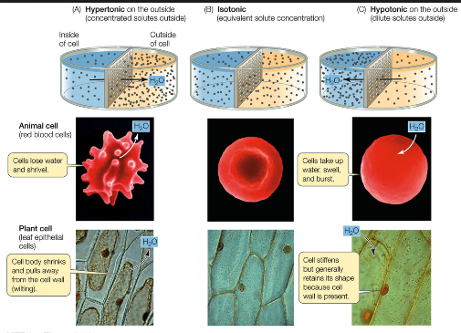
Passive Transport: Osmosis

Slide 12
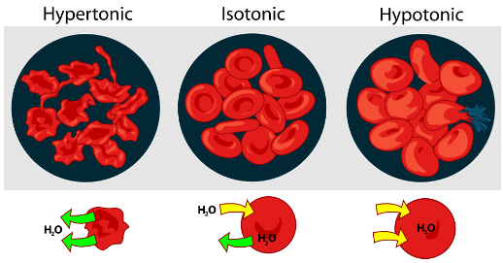
Passive Transport: Osmosis

Slide 13
Active Transport:
LOW TO HIGH
REQUIRES ENERGY

Slide 14
Active Transport: Endocytosis
A cell uses energy to import materials INTO the cell
Ex. White blood cells engulf bacteria to fight infection

Slide 15
Active Transport: Exocytosis
A cell uses energy to export materials OUT OF the cell
Ex. Nerve cells release neurotransmitters to pass signals to the brain

Slide 16
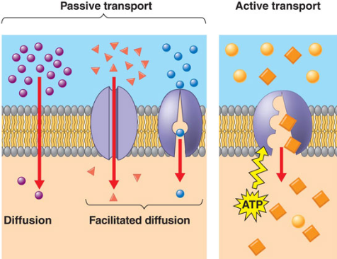

Slide 17
Practice Time!
Type of Transport | Passive/Active | Ex. of what is being moved | How it helps maintain homeostasis
Facilitated Diffusion |  |  | Regulates blood sugar
 | Active | Neurotransmitters
Endocytosis |  | Captures bacteria
 | Passive |  | Controls blood pressure by regulating blood volume
 | Passive | O₂ and CO₂

